Slide 1
SUPPORT SLIDES
City Bike Location Assessment

Slide 2
MAP SETUP

Slide 3
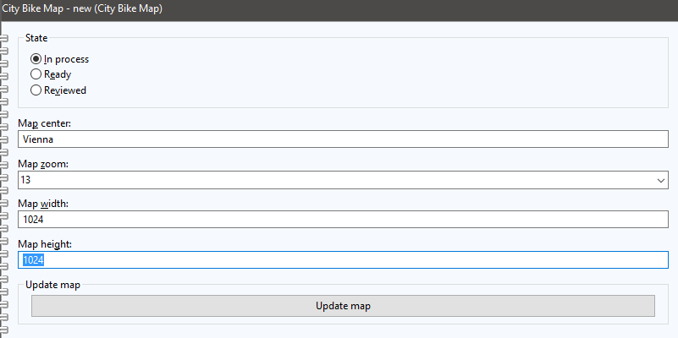
Prepare model and map
Create a new model
Define the center location (in model attribute „Map center“) and other map specification
Click „Update map“
Select result from API query and wait for download to complete

Slide 4
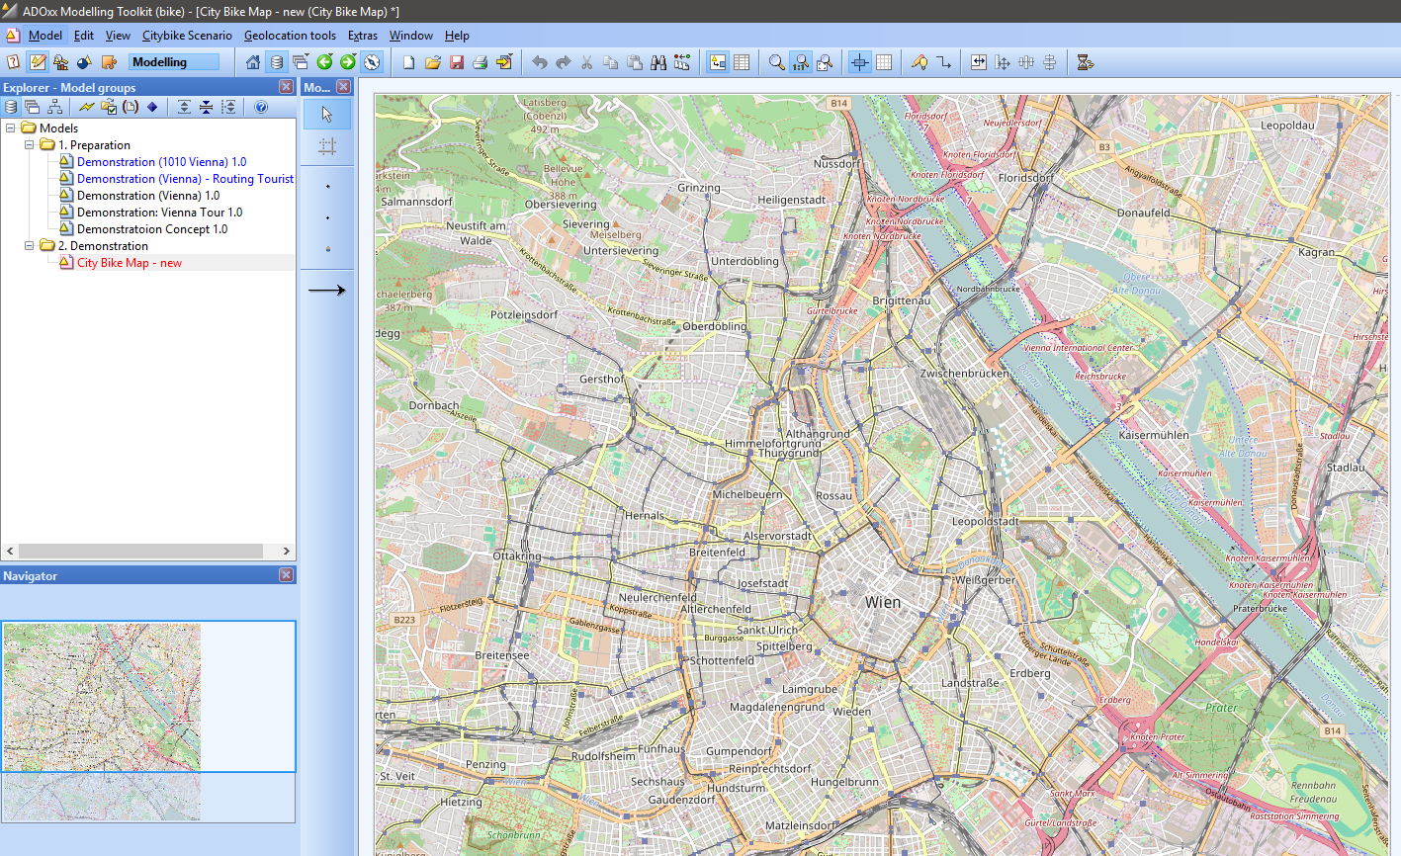
Result: Updated map and visualisation

Slide 5
DATA IMPORT

Slide 6
Import data into model
Run imports from CSV (see DOC file)
  Script for POI (in Menu Citybike Scenario -> 1. Model Preparation -> Import POI)
  Select POI file from DOC „SPAZIERPUNKTOGD_.csv“
  POI takes longer, ADOxx seems to be stuck, this is due to the large number of content cells
  Script for Citybike (in Menu Citybike Scenario -> 1. Model Preparation -> Import Citybikestation)
  Select citybike station from DOC „CITYBIKEOGD_.csv“
  Both files are downloads without modification from data.gv.at

Slide 7
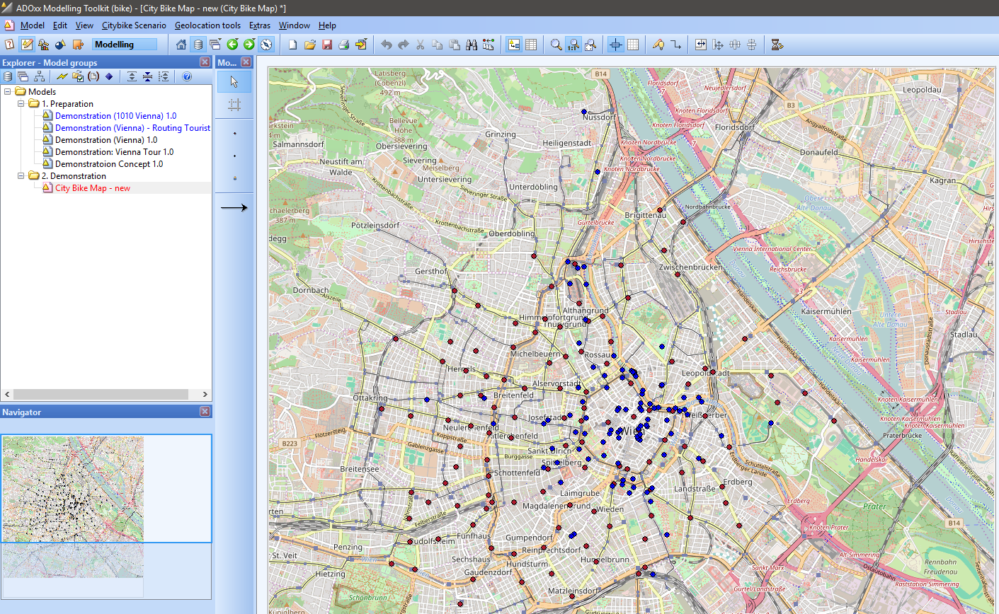
Result: Updated map and visualisation

Slide 8
LOCATION ASSESSMENT

Slide 9
Run Location assessment
ATTENTION: Takes some time to calculate
IDEA: the objective of this algorithm is to determine and visualize if enough city bike stops are close to a POI. This is done by defining a walking distance circle and count elements inside, plus color code
RUN by clicking on Citybike Scenario -> 2. Location assessment -> Assess locations
Model will close (SAVE if required) and opens automatically
SAVE the model to visualize the result

Slide 10
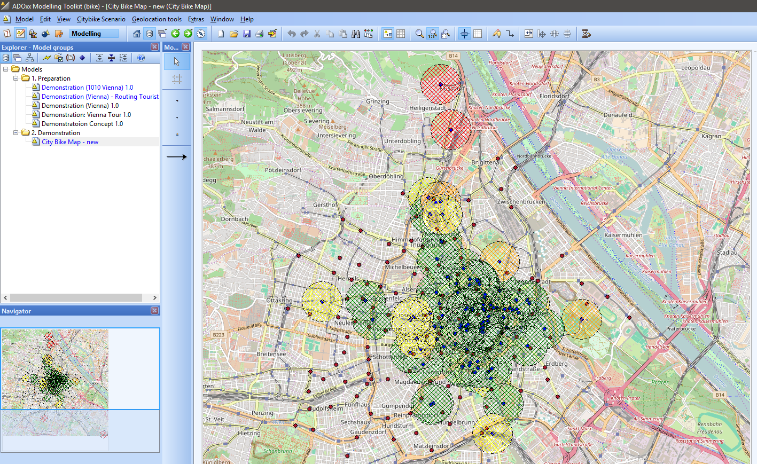
Result: Updated map and visualisation

Slide 11
ROUTING ASSESSMENT

Slide 12
Run Route Assessment
This algorithm requires a) at least one tourist object in the model and b) for each tourist a list of POIs (as INTERREFS in Notebook) from same model as attractions that the tourist wants to see
The calculation will guide the tourist through the city, distances are euclidian, no API interaction

Slide 13
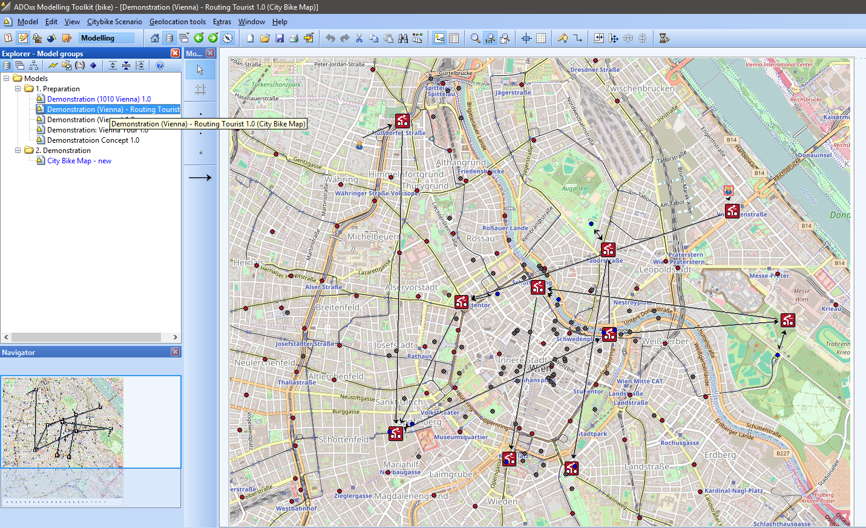
Result: Updated map and visualisation

